Slide 1
INFO-3135
Searching, Rebalancing Binary Search Trees (BST)

Slide 2
Review
Binary Search Tree (BST) Rules :
  the data of all the nodes in the left sub-tree of the root node should be <= the data of the root.
  the data of all the nodes in the right subtree of the root node should be > the data of the root.

Slide 3
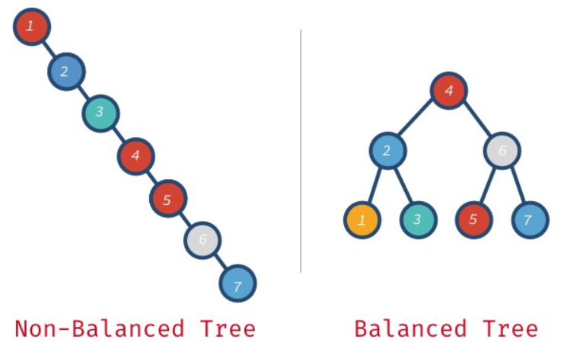
Review

Slide 4
Searching A Binary Search Tree
Uses a divide and conquer technique
  We can eliminate half of the nodes from our search each step until we find our value using the following algorithm:
  If search_value < current_node
    Move to left node
      If this node does not exist, the
      value does not exist in the tree
  If search_value > current_node
    Move to right node
      If this node does not exist, the
      value does not exist in the tree
  If search_value == current_node
    Found the node we are looking for

Slide 5
Searching A Binary Search Tree
Let’s implement a search functionality to the BinaryTree class we created in week.
  We will do two implementations
    One recursive
    One iterative

Slide 6
Rebalancing Binary Trees
  The performance of the search depends on if the tree is balanced or not.
  With an unbalanced tree we may have to visit every node before we find our value.
    Divide and conquer doesn’t work here
      Worst Case O(n) to find our element
  This is the same performance as linked list.
    Not a surprise if we look at the structure

Slide 7
Rebalancing Binary Trees
  How do we convert the non-balanced tree to a balanced?

Slide 8
Rebalancing Binary Trees
  The algorithm:
    Traverse the BST inorder and place the values into an array (vector)
      This returns the existing values in sorted sequence.
    Build a balanced tree using the sorted array
      Find the middle and make it root
      Recursively do the same for both the left and right half of the array
        Get the middle of left half
          Make it left child of the root
        Get the middle of right half
          Make it right child of the root

Slide 9
Rebalancing Binary Trees
1 | 2 | 3 | 4 | 5
Node* reconstruct(arr, min, max){
if(min>max) return nullptr;
mid = (max-min)/2;
root = new Node(arr[mid]);
root->left = reconstruct(arr, min, mid -1) ;
root->right = reconstruct(arr, mid+1, max);
return root;
}

Slide 10
Rebalancing Binary Trees
Before we code:
  Quiz #6
    Due next week
    Graph Terminology / Definitions
Let’s code it up:
  We will also code up a naive function to check if our BST is unbalanced.

